Slide 1

Dialysis
By: Gangumolu Sri Harsha Shanmukh

Slide 2
Dialysis
By: Gangumolu Sri Harsha Shanmukh

Slide 3
What is Dialysis?
Dialysis is a medical procedure used to remove waste products and excess fluids from the blood when the kidneys are no longer able to perform this function adequately. It is typically used for patients with kidney failure or severe kidney disease.

Slide 4
Types of Dialysis?
Dialysis is a medical procedure used to remove waste products and excess fluids from the blood when the kidneys are no longer able to perform this function adequately. It is typically used for patients with kidney failure or severe kidney disease.
There are two main types of dialysis:
Hemodialysis: This involves using a machine called a dialyzer to filter the blood outside the body. The patient's blood is pumped through the dialyzer, which contains a special membrane that allows waste products and excess fluids to pass out of the blood and into a dialysis solution. The cleaned blood is then returned to the body.
Peritoneal dialysis: In this method, the lining of the abdomen (the peritoneum) is used as a natural filter. A cleansing fluid is introduced into the abdomen through a catheter, and after a period of time where the fluid absorbs waste products and excess fluids from the blood vessels in the abdominal lining, it is drained out.

Slide 5
Safety Precaution of Dialysis
Both types of dialysis require careful monitoring and adherence to a strict treatment schedule to ensure that the body's electrolyte balance and fluid levels are maintained within safe limits. While dialysis can help to prolong and improve the quality of life for many people with kidney failure, it is not a cure for the underlying condition and may be needed indefinitely unless a kidney transplant becomes an option.

Slide 6
The above GIF is the process of dialysis

Slide 7
Fun Facts about Dialysis and Artificial Kidneys
Dialysis can perform regular functions that your kidneys are no longer able to perform themselves.
Dialysis helps to keep your body’s potassium, phosphorus, and sodium levels balanced.
Dialysis empowers you to live a full, active life with kidney failure.
There are two types of dialysis: hemodialysis and peritoneal dialysis.
More and more people are choosing home dialysis, which can offer greater flexibility and better outcomes.
The best dialysis option for you is the one that best fits your lifestyle and health needs.
Many people switch dialysis treatment types to fit a changing lifestyle at some point during long-term treatment.

Slide 8
Artificial Kidneys
Artificial kidneys, also known as kidney dialysis machines, are devices designed to perform the functions of natural kidneys when a person's own kidneys are unable to do so effectively. These machines are used in the process of hemodialysis, a treatment for patients with kidney failure or severe kidney disease.

Slide 9
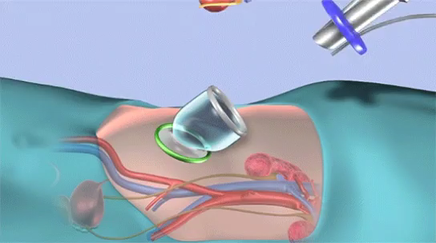
Installation Of Artificial Kidneys

Slide 10
Question about Dialysis
What happens when both the kidneys of a person stop working either due to an infection or an injury?
When both kidneys of a person stop working, due to an infection or an injury, the body can no longer filter waste products from the blood. As a result, toxins build up in the bloodstream, which can be life-threatening. To prevent this, periodic blood filtration is necessary, which can be achieved by using an artificial kidney or a dialysis machine. Dialysis is a process that involves separating toxic substances from the blood when the kidneys are unable to do so. This procedure is also known as an artificial kidney.

